Slide 1
Gravity Equation Estimation Using Stata
Guoxuan
UIBE

Slide 2
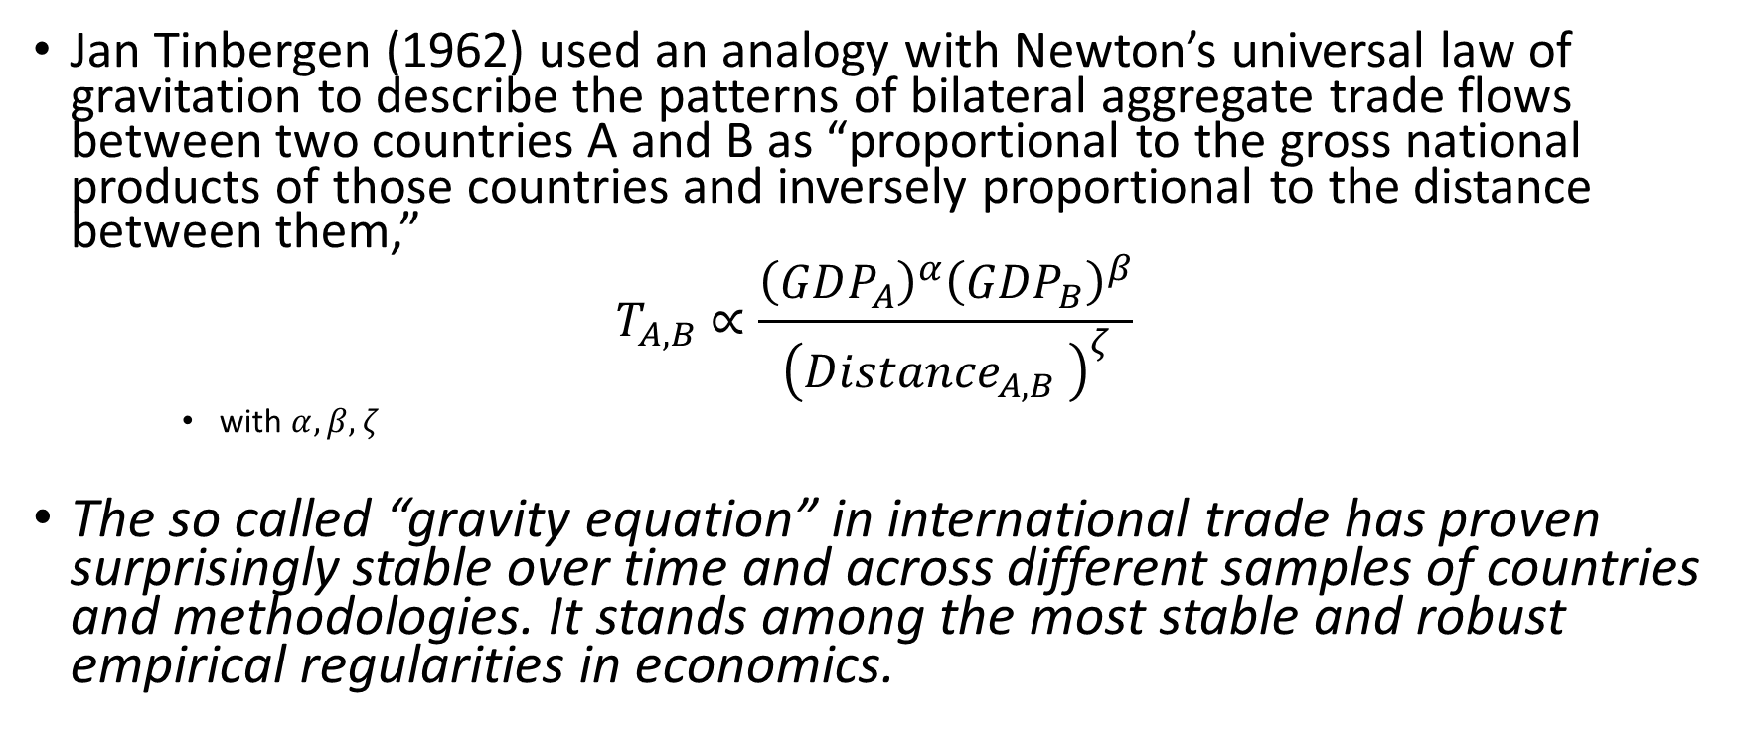
International Trade and Gravity Equation
Jan Tinbergen (1962) used an analogy with Newton’s universal law of gravitation to describe the patterns of bilateral aggregate trade flows between two countries A and B as “proportional to the gross national products of those countries and inversely proportional to the distance between them,”
$$T_{A,B}∝\frac{{\left(GDP_{A}\right)}^{α}{\left(GDP_{B}\right)}^{β}}{{\left({Distance}_{A,B} \right)}^{ζ}}$$
with $α,β,ζ$
The so called “gravity equation” in international trade has proven surprisingly stable over time and across different samples of countries and methodologies. It stands among the most stable and robust empirical regularities in economics.

Slide 3
Gravity Equation
Over the last half-century, the gravity model has become the workhorse of the applied international trade literature.
By linking trade flows directly with economic size and inversely with trade costs, usually proxied by geographical distance as an indicator of transport costs, the gravity model captures some deep regularities in the pattern of international trade and production.
The gravity model is a key tool for researchers interested in the effects of trade-related policies.
It provides a convenient testing bed on which to assess the trade impacts of different policies.
Traditionally, gravity models have been based largely on intuitive ideas as to which variables are likely to influence trade.
More recently, however, a number of “theoretical” gravity models have been developed, which use various micro-founded theories of international trade to develop gravity-like models.
The current trend in the literature is towards the use of one of a number of “structural” (i.e., theoretically grounded) gravity models, which provide consistent and unbiased parameter estimates, as well as an appropriate platform for conducting counterfactual simulations.

Slide 4
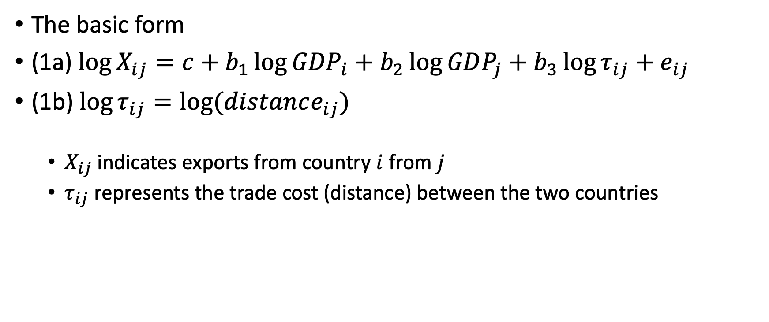
The Gravity Intuition
The basic form
(1a) $\log{X_{ij}=c+b_{1}{\log{GDP}}_{i}+b_{2}\log{GDP_{j}}+b_{3}\log{τ_{ij}}+e_{ij}}$
(1b) $\log{τ_{ij}}=\log{(distance_{ij})}$
$X_{ij}$ indicates exports from country $i$ from $j$
$τ_{ij}$ represents the trade cost (distance) between the two countries

Slide 5
The name “gravity” comes from the fact that the nonlinear form of equation 1a resembles Newton’s law of gravity: exports are directly proportional to the exporting and importing countries’ economic “mass” (GDP), and inversely proportional to the distance between them (not the square of the distance between them, as in physics).
In other words, gravity says that we expect larger country pairs to trade more, but we expect countries that are further apart to trade less, perhaps because transport costs between them are higher

Slide 6
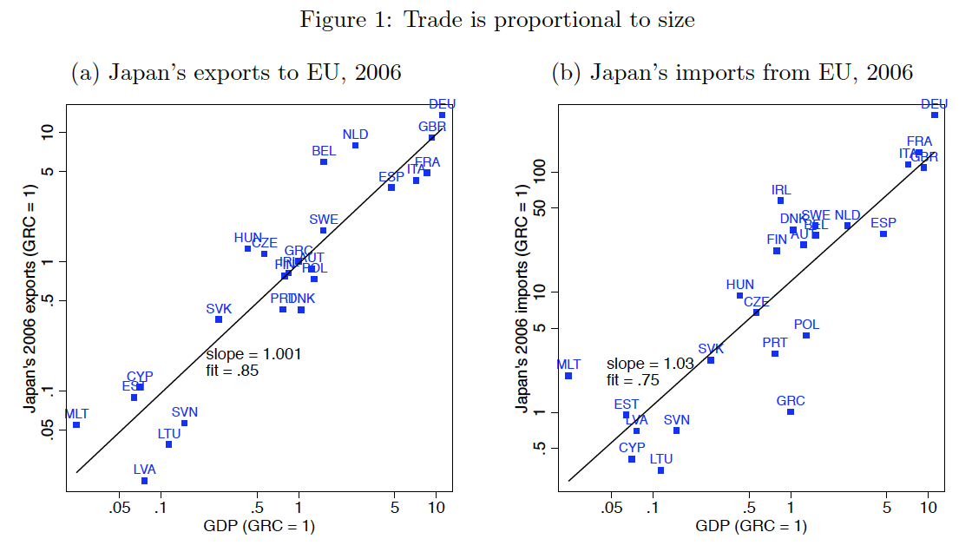

Slide 7
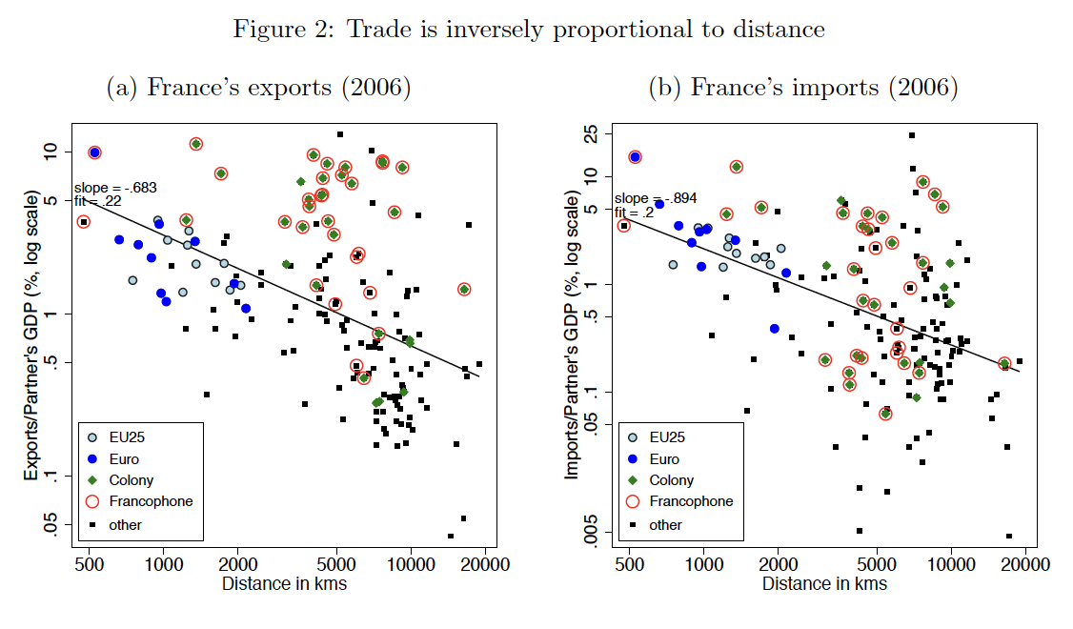

Slide 8
Data set
Dataset on bilateral trade in services compiled by Francois et al. (2009).
Sector: SER
Dataset download
servicesdataset 2.dta

Slide 9
gen ln_trade = ln(trade)
gen ln_distance = ln(dist)
gen ln_gdp_exp = ln(gdp_exp)
gen ln_gdp_imp = ln(gdp_imp)
correlate ln_trade ln_gdp_exp

Slide 10
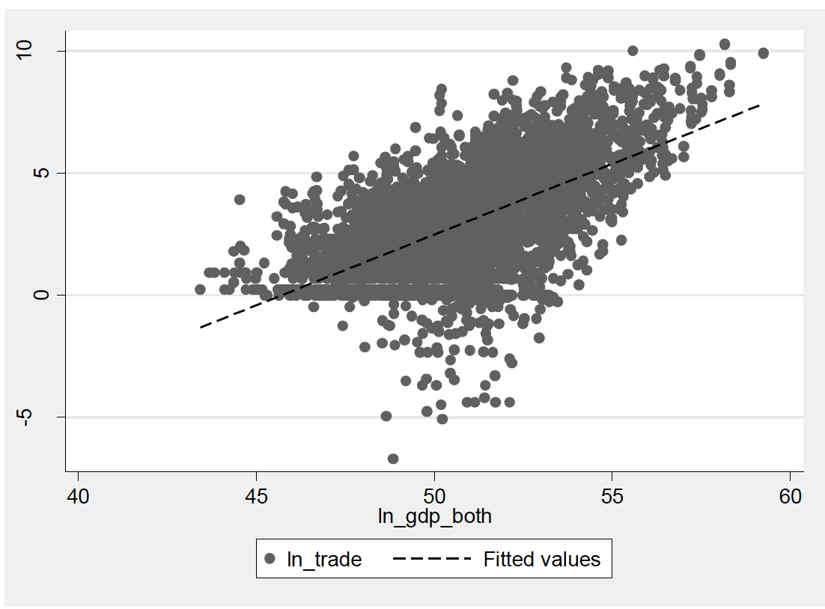
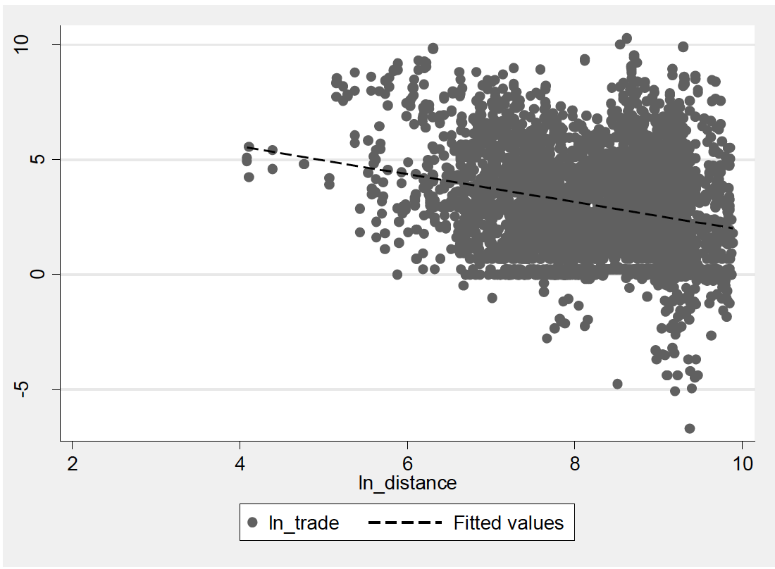
gen ln_gdp_both = ln(gdp_exp*gdp_imp)
twoway (scatter ln_trade ln_gdp_both if sector == “SER”) (lfit ln_trade ln_gdp_both if sector ==“SER”)
twoway (scatter ln_trade ln_distance if sector == “SER”) (lfit ln_trade ln_distance if sector == “SER”)

Slide 11
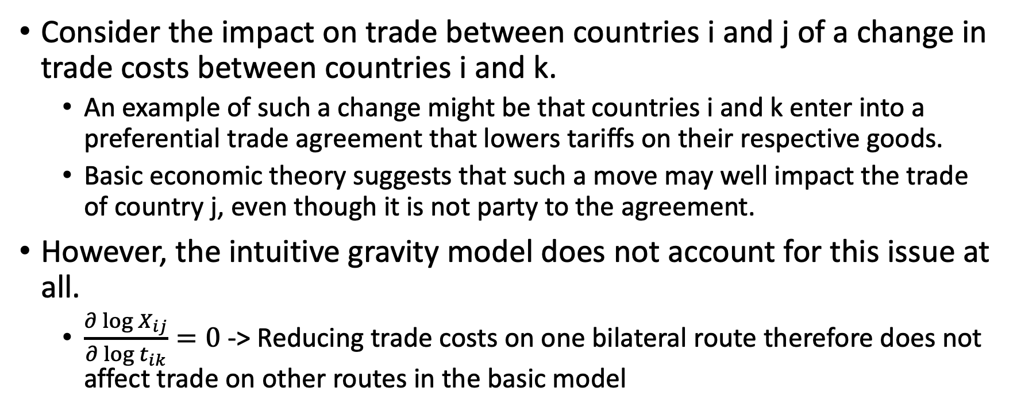
Problems with the Intuitive Gravity Model
Consider the impact on trade between countries i and j of a change in trade costs between countries i and k.
An example of such a change might be that countries i and k enter into a preferential trade agreement that lowers tariffs on their respective goods.
Basic economic theory suggests that such a move may well impact the trade of country j, even though it is not party to the agreement.
However, the intuitive gravity model does not account for this issue at all.
$\frac{∂\log{X_{ij}}}{∂\log{t_{ik}}}=0$ -> Reducing trade costs on one bilateral route therefore does not affect trade on other routes in the basic model

Slide 12
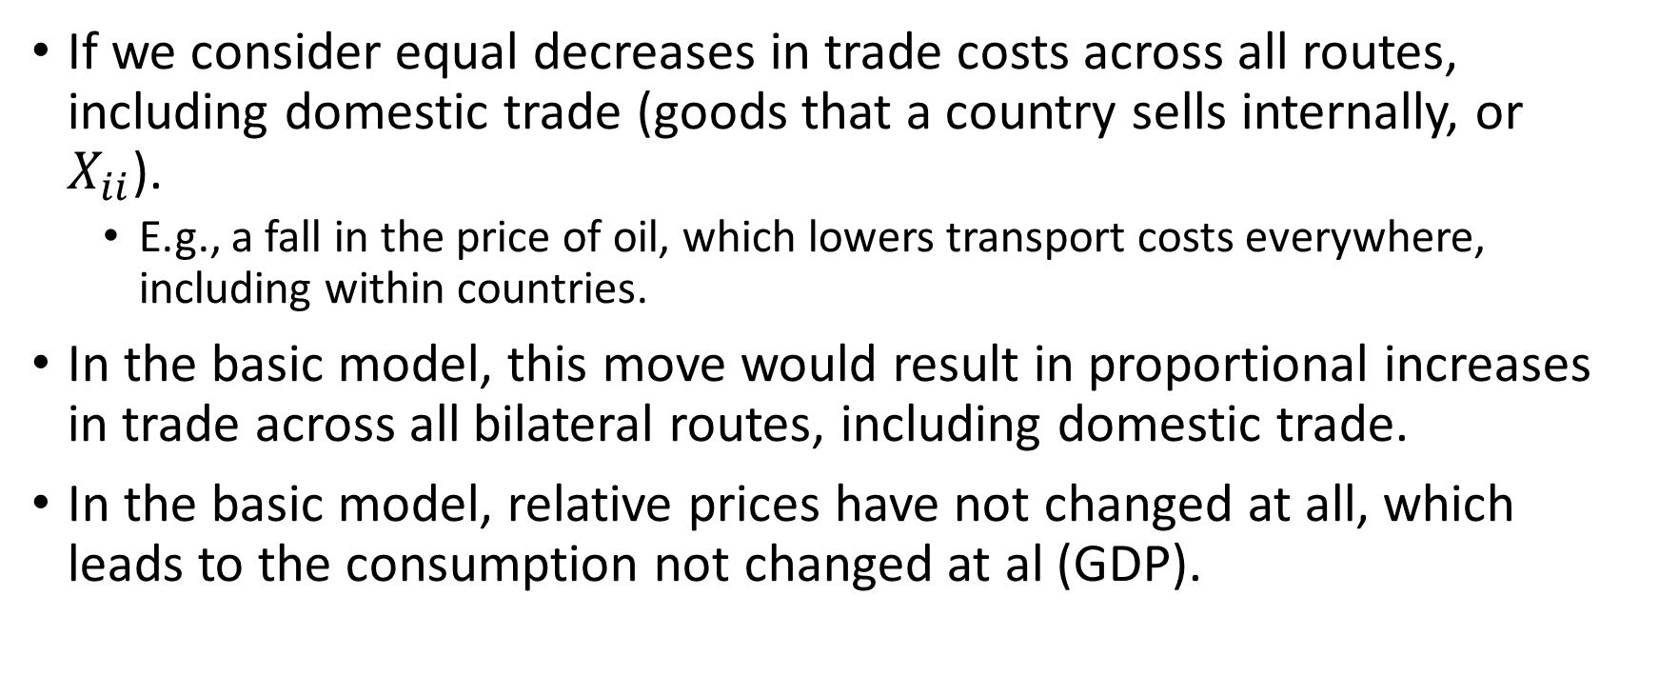
Problems with the Intuitive Gravity Model
If we consider equal decreases in trade costs across all routes, including domestic trade (goods that a country sells internally, or $X_{ii}$).
E.g., a fall in the price of oil, which lowers transport costs everywhere, including within countries.
In the basic model, this move would result in proportional increases in trade across all bilateral routes, including domestic trade.
In the basic model, relative prices have not changed at all, which leads to the consumption not changed at al (GDP).

Slide 13
Issues such as those identified previously led some researchers to turn to theory to provide a basis for a gravity-like model of trade.
The first example of such an approach is Anderson (1979).
The famous “gravity with gravitas” model of Anderson and Van Wincoop (2003).

Slide 14
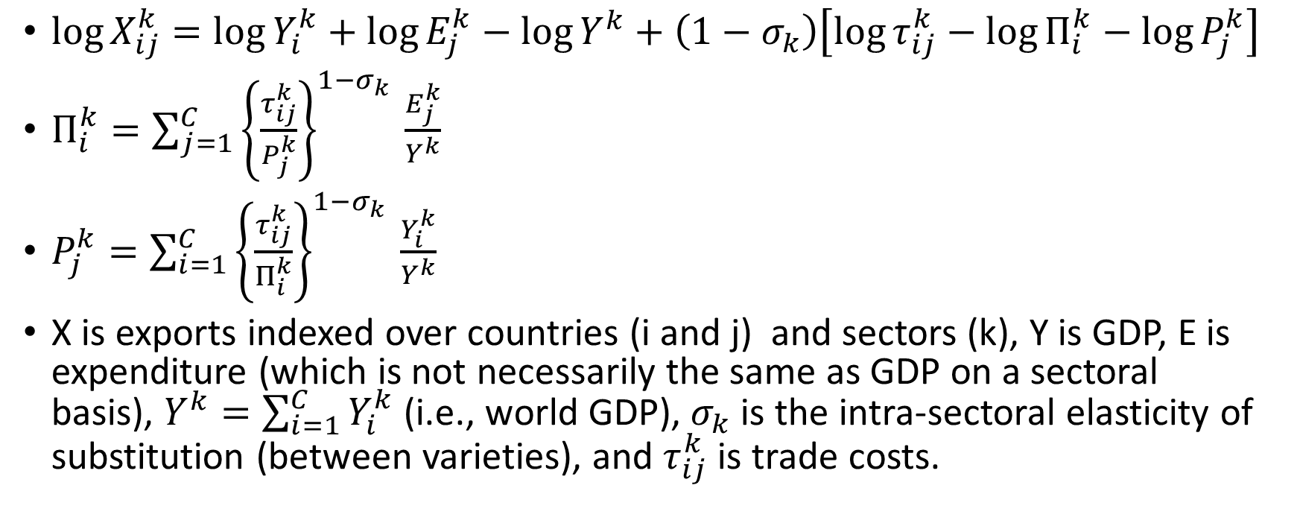
$\log{X_{ij}^{k}}=\log{Y_{i}^{k}}+\log{E_{j}^{k}}−\log{Y^{k}}+\left(1−σ_{k}\right)\left[\log{τ_{ij}^{k}}−\log{Π_{i}^{k}}−\log{P_{j}^{k}}\right]$
$Π_{i}^{k}=\sum_{j=1}^{C}{{\left\{\frac{τ_{ij}^{k}}{P_{j}^{k}}\right\}}^{1−σ_{k }}\frac{E_{j}^{k}}{Y^{k}}}$
$P_{j}^{k}=\sum_{i=1}^{C}{{\left\{\frac{τ_{ij}^{k}}{Π_{i}^{k}}\right\}}^{1−σ_{k }}\frac{Y_{i}^{k}}{Y^{k}}}$
X is exports indexed over countries (i and j) and sectors (k), Y is GDP, E is expenditure (which is not necessarily the same as GDP on a sectoral basis), $Y^{k}=\sum_{i=1}^{C}{Y_{i}^{k}}$ (i.e., world GDP), $σ_{k}$ is the intra-sectoral elasticity of substitution (between varieties), and $τ_{ij}^{k}$ is trade costs.

Slide 15
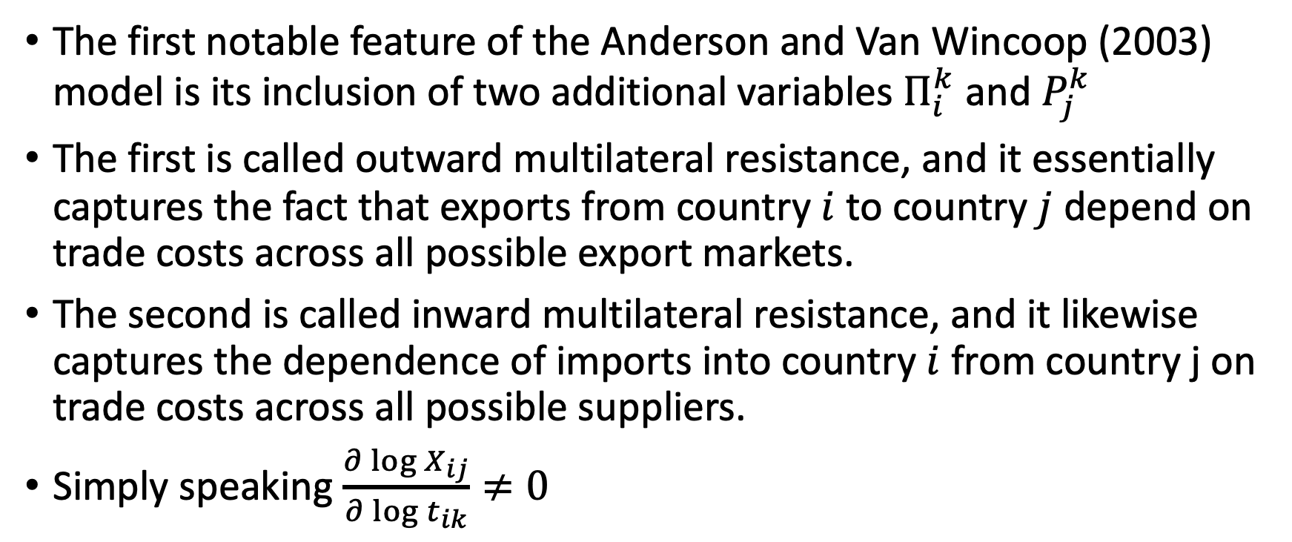
The first notable feature of the Anderson and Van Wincoop (2003) model is its inclusion of two additional variables $Π_{i}^{k}$ and $P_{j}^{k}$
The first is called outward multilateral resistance, and it essentially captures the fact that exports from country $i$ to country $j$ depend on trade costs across all possible export markets.
The second is called inward multilateral resistance, and it likewise captures the dependence of imports into country $i$ from country j on trade costs across all possible suppliers.
Simply speaking $\frac{∂\log{X_{ij}}}{∂\log{t_{ik}}}≠0$

Slide 16
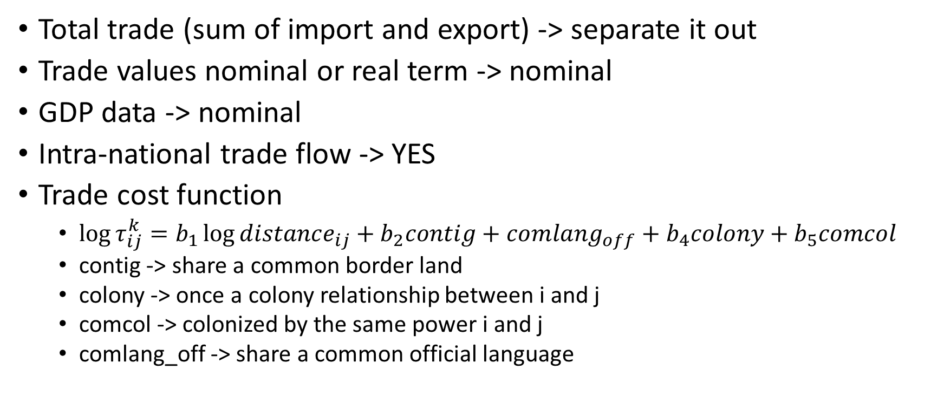
Empirical Corrections
Total trade (sum of import and export) -> separate it out
Trade values nominal or real term -> nominal
GDP data -> nominal
Intra-national trade flow -> YES
Trade cost function
$\log{τ_{ij}^{k}}=b_{1}\log{distance_{ij}}+b_{2}contig+comlang_{off}+b_{4}colony+b_{5}comcol$
contig -> share a common border land
colony -> once a colony relationship between i and j
comcol -> colonized by the same power i and j
comlang_off -> share a common official language

Slide 17
Estimating Gravity Equation
Standard OLS assumptions
reg ln_trade ln_gdp_exp ln_gdp_imp ln_distance contig comlan_off colony comcol if sector == “SER”, robust cluster(dist)
we need to look more closely at the estimated coefficients and their corresponding t-tests
importer and exporter GDP are both positively associated with trade
The coefficient on distance is negative and 1% statistically significant
Of the remaining geographical and historical variables, all except the common colonizer dummy have the expected positively signed coefficient and are statistically significant at the 5% level or better.

Slide 18
Tests
GDP coefficients in the goods trade literature are frequently found to be close to unity—and some theories suggest they should be exactly unity—so we can test whether that is in fact the case in our services data.
test (ln_gdp_exp = ln_gdp_imp = 1)
Using the same approach, we can test the compound hypothesis that historical and cultural links do not matter for trade in services
test (contig = comlang_off = colony = comcol = 0 )

Slide 19
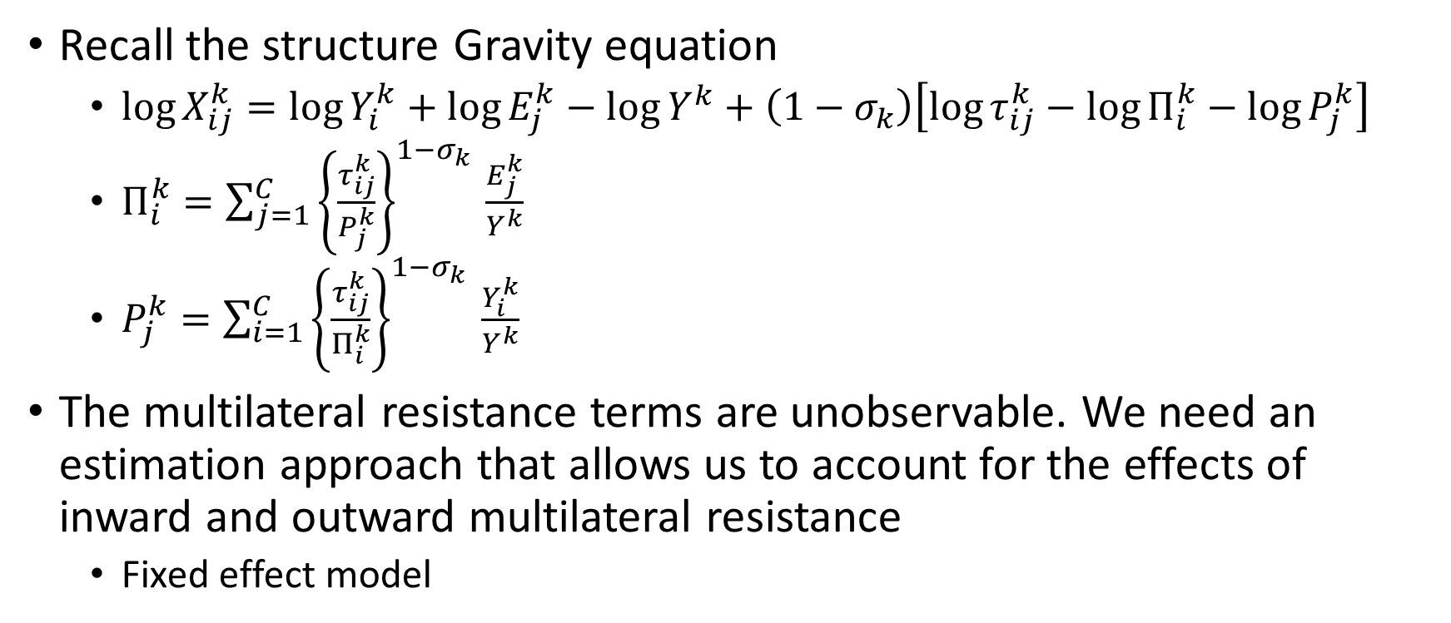
Fixed effect
Recall the structure Gravity equation
$\log{X_{ij}^{k}}=\log{Y_{i}^{k}}+\log{E_{j}^{k}}−\log{Y^{k}}+\left(1−σ_{k}\right)\left[\log{τ_{ij}^{k}}−\log{Π_{i}^{k}}−\log{P_{j}^{k}}\right]$
$Π_{i}^{k}=\sum_{j=1}^{C}{{\left\{\frac{τ_{ij}^{k}}{P_{j}^{k}}\right\}}^{1−σ_{k }}\frac{E_{j}^{k}}{Y^{k}}}$
$P_{j}^{k}=\sum_{i=1}^{C}{{\left\{\frac{τ_{ij}^{k}}{Π_{i}^{k}}\right\}}^{1−σ_{k }}\frac{Y_{i}^{k}}{Y^{k}}}$
The multilateral resistance terms are unobservable. We need an estimation approach that allows us to account for the effects of inward and outward multilateral resistance
Fixed effect model

Slide 20
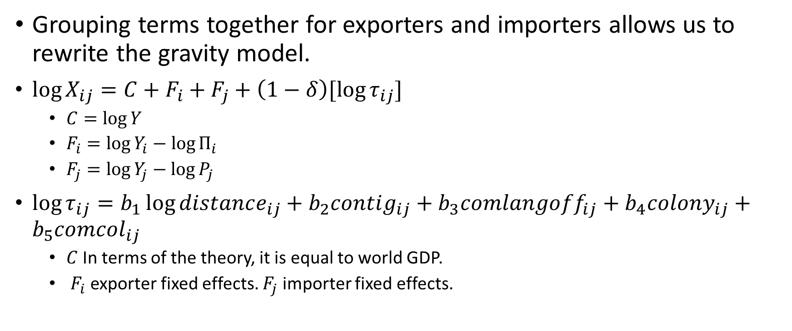
Fixed Effects Estimation
Grouping terms together for exporters and importers allows us to rewrite the gravity model.
$\log{X_{ij}}=C+F_{i}+F_{j}+\left(1−δ\right)[\log{τ_{ij}}]$
$C=\log{Y}$
$F_{i}=\log{Y_{i}}−\log{Π_{i}}$
$F_{j}=\log{Y_{j}}−\log{P_{j}}$
$\log{τ_{ij}}=b_{1}\log{distance_{ij}}+b_{2}contig_{ij}+b_{3}comlangoff_{ij}+b_{4}colony_{ij}+b_{5}comcol_{ij}$
$C$ In terms of the theory, it is equal to world GDP.
$F_{i}$ exporter fixed effects. $F_{j}$ importer fixed effects.

Slide 21
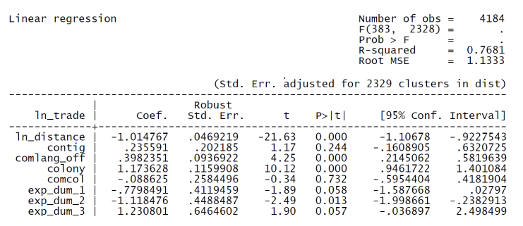
egen exporters = group(exp)
egen importers = group(imp)
reg ln_trade ln_distance contig comlan_off colony comcol i.exporters i.importers if sector == “SER”, robust cluster(dist)

Slide 22
The model’s explanatory power is much greater
The distance elasticity is very close to -1 under fixed effect
Number of dummies is large, recommend reghdfe
Fixed effect Problem:
Need to drop from the model any variables that are collinear with the fixed effects.
It is not possible to estimate a fixed effects model that also includes data that only vary by exporter (constant across all importers) or by importer (constant across all exporters)
One way of dealing with this problem that does not require extra data is to take variables that vary by exporter or importer and transform them artificially into a variable that varies bilaterally
Then random effect~

Slide 23
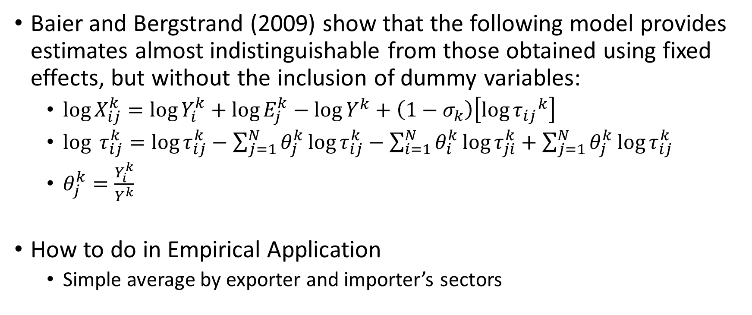
Baier and Bergstrand (2009)
Baier and Bergstrand (2009) show that the following model provides estimates almost indistinguishable from those obtained using fixed effects, but without the inclusion of dummy variables:
$\log{X_{ij}^{k}}=\log{Y_{i}^{k}}+\log{E_{j}^{k}}−{\log{Y}}^{k}+\left(1−σ_{k}\right)\left[{\log{τ_{ij}}}^{k}\right]$
$\log{ τ_{ij}^{k}}=\log{τ_{ij}^{k}}−\sum_{j=1}^{N}{θ_{j}^{k}\log{τ_{ij}^{k}}}−\sum_{i=1}^{N}{θ_{i}^{k}\log{τ_{ji}^{k}}}+\sum_{j=1}^{N}{θ_{j}^{k}\log{τ_{ij}^{k}}}$
$θ_{j}^{k}=\frac{Y_{i}^{k}}{Y^{k}}$
How to do in Empirical Application
Simple average by exporter and importer’s sectors

Slide 24
egen temp1 = mean(ln_distance), by(exp sector)
egen temp2 = mean(ln_distance), by(imp sector)
egen temp3 = sum(ln_distance), by(sector)
reg ln_trade ln_distance_star ln_gdp_exp ln_gdp_imp if sector == “SER”, robust cluster(dist)

Slide 25
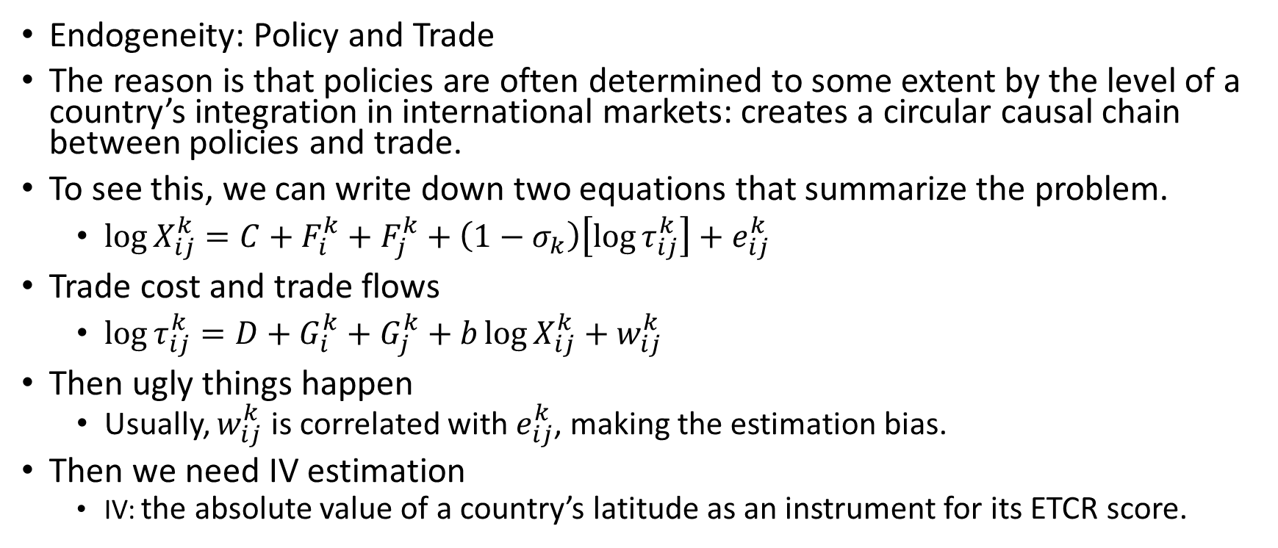
Dealing with Endogeneity
Endogeneity: Policy and Trade
The reason is that policies are often determined to some extent by the level of a country’s integration in international markets: creates a circular causal chain between policies and trade.
To see this, we can write down two equations that summarize the problem.
$\log{X_{ij}^{k}}=C+F_{i}^{k}+F_{j}^{k}+\left(1−σ_{k}\right)\left[\log{τ_{ij}^{k}}\right]+e_{ij}^{k}$
Trade cost and trade flows
$\log{τ_{ij}^{k}}=D+G_{i}^{k}+G_{j}^{k}+b\log{X_{ij}^{k}}+w_{ij}^{k}$
Then ugly things happen
Usually, $w_{ij}^{k}$ is correlated with $e_{ij}^{k}$, making the estimation bias.
Then we need IV estimation
IV: the absolute value of a country’s latitude as an instrument for its ETCR score.

Slide 26
gen ln_lat_exp = ln(abs(lat_exp))
gen ln_lat_imp = ln(abs(lat_imp))
ivreg2 ln_trade(etcr_exp etcr_imp = ln_lat_exp ln_lat_imp) ln_gdp_exp ln_gdp_imp ln_distance contig complang_off colony comcol, robust cluster(dist) first endog( etcr_exp etcr_imp)

Slide 27
Heckman Sample Selection
As noted above, zero trade flows are relatively common in the bilateral trade matrix. As the level of product disaggregation becomes greater, so do zeros become more frequent. Even using aggregate trade data, Helpman et al. (2008) report that around half of the bilateral trade matrix is filled with zeros.
Dropping these observations—as OLS automatically does because the logarithm of zero is undefined— immediately gives rise to concerns about sample selection bias.
The sample from which the regression model is estimated is not drawn randomly from the population (all trade flows), but only consists of those trade flows which are strictly positive.
One way of dealing with this problem is to use the sample selection correction introduced by Heckman (1979). Helpman et al. (2008) develop a model of international trade that yields a gravity equation with a Heckman correction combined with an additional correction for firm heterogeneity.

Slide 28
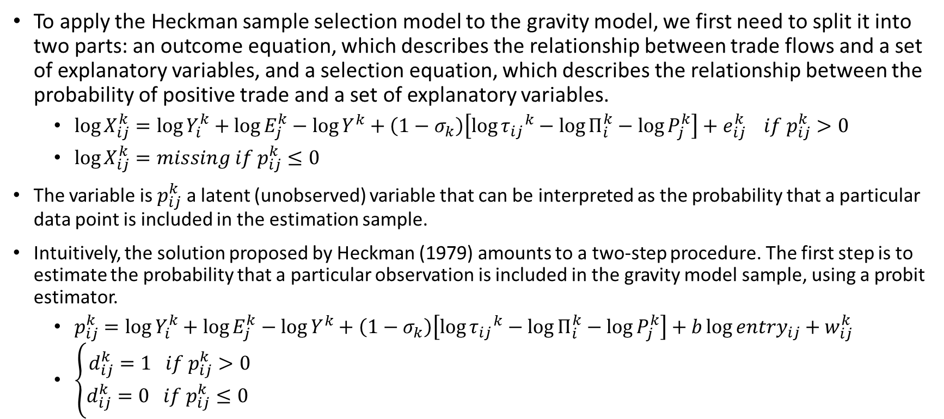
To apply the Heckman sample selection model to the gravity model, we first need to split it into two parts: an outcome equation, which describes the relationship between trade flows and a set of explanatory variables, and a selection equation, which describes the relationship between the probability of positive trade and a set of explanatory variables.
$\log{X_{ij}^{k}}=\log{Y_{i}^{k}}+\log{E_{j}^{k}}−\log{Y^{k}}+\left(1−σ_{k}\right)\left[{\log{τ_{ij}}}^{k}−\log{Π_{i}^{k}}−\log{P_{j}^{k}}\right]+e_{ij}^{k} if p_{ij}^{k}>0$
$\log{X_{ij}^{k}}=missing if p_{ij}^{k}≤0$
The variable is $p_{ij}^{k}$ a latent (unobserved) variable that can be interpreted as the probability that a particular data point is included in the estimation sample.
Intuitively, the solution proposed by Heckman (1979) amounts to a two-step procedure. The first step is to estimate the probability that a particular observation is included in the gravity model sample, using a probit estimator.
$p_{ij}^{k}=\log{Y_{i}^{k}}+\log{E_{j}^{k}}−\log{Y^{k}}+\left(1−σ_{k}\right)\left[{\log{τ_{ij}}}^{k}−\log{Π_{i}^{k}}−\log{P_{j}^{k}}\right]+b\log{entry_{ij}}+w_{ij}^{k}$
$\left\{\begin{aligned}d_{ij}^{k}=1 if p_{ij}^{k}>0 \\ d_{ij}^{k}=0 if p_{ij}^{k}≤0 \end{aligned}\right.$

Slide 29
The selection equation relates the latent variable to a set of observed explanatory variables. That set must include all variables in the outcome equation, and preferably at least one additional variable that affects the probability that two countries engage in trade, but not the volume of such trade once it takes place
i,.e., market entry in the exporter and the importer from the World Bank’s Doing Business dataset
heckman ln_trade ln_distance contig comlang_off colony comcol i.exporters I.importers if sector == “SER”, select(ln_distance contig comlang_off colony comcol ent_cost_both i.exporter i.importers) robust cluster(dist)

Slide 30
Limitations of Gravity Model
The gravity model describes the behavior of trade flows, but not economic welfare as such.
For applications that focus on economic welfare, it would be more appropriate to use other methodologies, such as computable general equilibrium modeling, rather than gravity.

Slide 31
Final Exam Project
Replicate Helpman et al. (2008) Results
Your Research Summary

